Slide 1
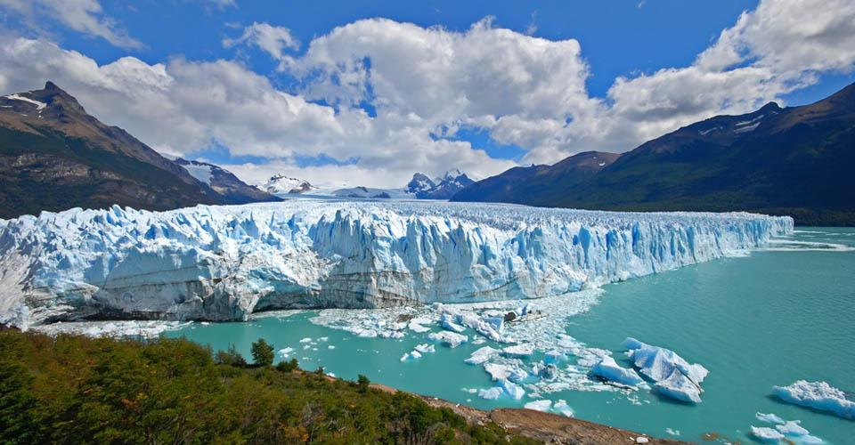
Save the Los Glaciares National Park
Where….
Located in the Austral Andes in Argentina. The National Park was created in 1937 and contains 47 large glaciers and 200 smaller ones.
Why is the park at risk?
The ocean temperature worldwide has caused glaciers in the park to melt at a very rapid pace.
How can you help to save it??
To save this landmark we must acknowledge the direct effect the warming ocean has on glaciers. Please be mindful of your carbon footprint and its effect on the world.
Why is it important??
Los Glaciares is significant to Argentina’s culture as it is home to many endangered animals. The Wildlife include guanacos, chinchillas, condors and rheas. These are important animals to Argentina’s cultural identity.
Picture courtesy of www.briticanna.org
Help to rebuild the park!!

